Slide 1
Development of a concept for data-based condition monitoring and structural health monitoring strategies for the use phase of hybrid components
Masterarbeit
IWF – Nachhaltige Produktion & Life Cycle Engineering
Peiran, WANG Stand: 04.08.2022

Slide 2
Contents
Motivation and objective
State of the art
Methodology
Case Study
Summary and Critical appraisal
Outlook
Development of a concept for data-based condition monitoring and structural health monitoring strategies for the use phase of hybrid components
04. August | Peiran Wang | Seit 1
Notes:
These are the main contents to be introduced

Slide 3
Contents
Motivation and Objective
State of the art
Methodology
Case Study
Summary and Critical appraisal
Outlook
Development of a concept for data-based condition monitoring and structural health monitoring strategies for the use phase of hybrid components
04. August | Peiran Wang | Seit 2
Notes:
First of all, I want to talk about the Motivation and Objective

Slide 4

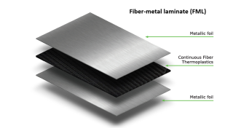
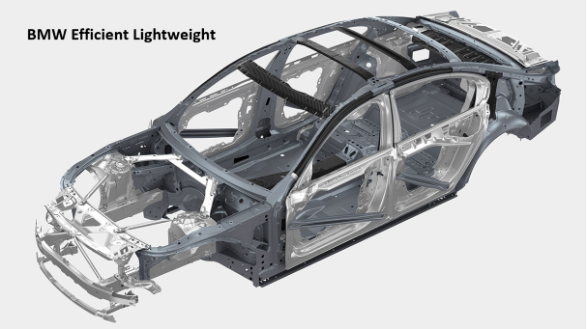
Motivation and Objective
Application of hybrid structures
Upper roof rail [2]
BMW Efficient Lightweight [1]
Fiber-metal laminate (FML) [3]
Development of a concept for data-based condition monitoring and structural health monitoring strategies for the use phase of hybrid components
04. August | Peiran Wang | Seit 3
Notes:
With the development and application of hybrid 海不瑞d structures,
It makes an important contribution to the lightweight of vehicles.

Slide 5
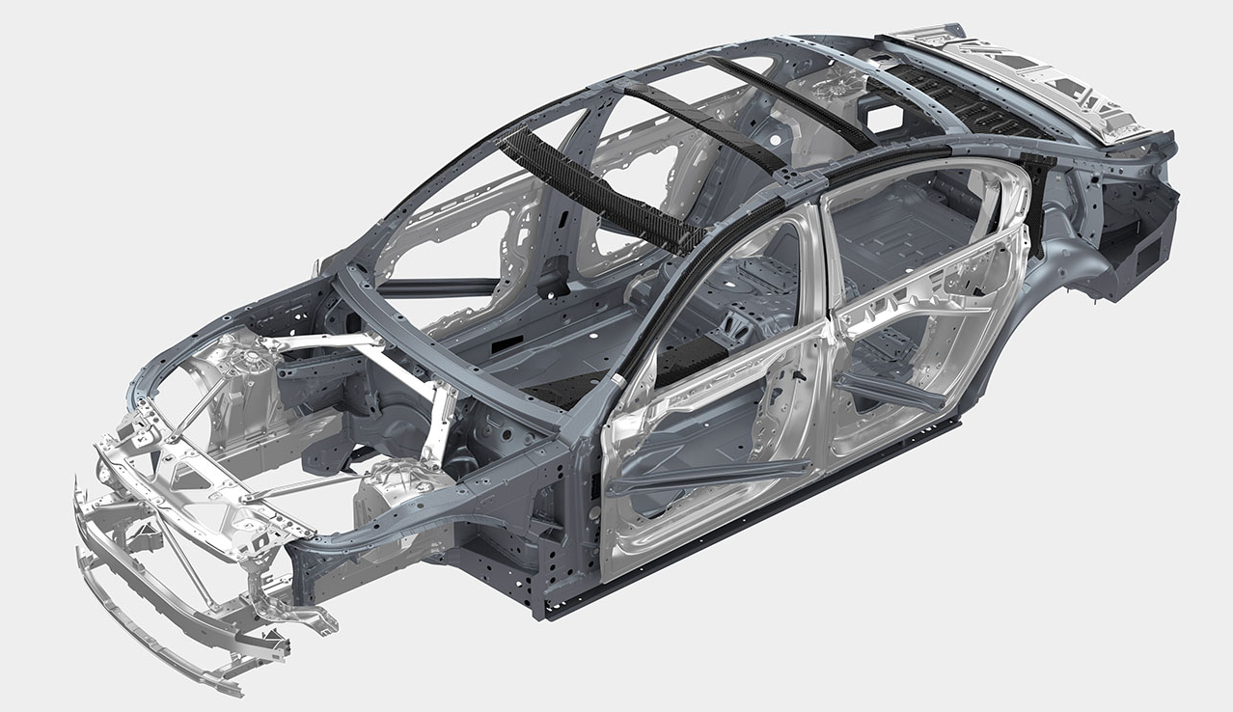

BMW EfficientLightweight
BMW Efficient Lightweight
Notes:
For example, BMW Efficient Lightweight technology, 1非神t 太可

Slide 6

2016 BMW 7 Series Upper roof rail reinforcement CFRP
Notes:
Upper roof rail with CFRP reinforced structure. 为哦 瑞inforced

Slide 7
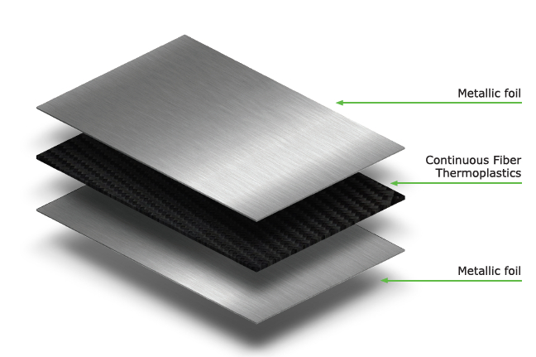
Fiber-metal laminate (FML)
Notes:
This is another form fiber-metal laminate. 卖头 f爱ber lai米内t

Slide 8
Motivation and objective
The importance of monitoring system
Difference between CM and SHM
Data collection and analysis
Damage Identification
Optimize the design of the structure
CM is used for the monitoring of rotating and reciprocating machinery, such as wind turbine components.
SHM can use a sensing network embedded inside or integrated on the surface of the structure to sense the structure’s health status in real time online.
Common monitoring system for use phase
Condition Monitoring (CM)
Structural Health Monitoring (SHM)
Development of a concept for data-based condition monitoring and structural health monitoring strategies for the use phase of hybrid components
04. August | Peiran Wang | Seit 4
Notes:
The application of new technologies also brings new problems.
In order to be able to know the life cycle of hybrid structures, we need monitoring systems.
The monitoring system can collect data and analyze damage, and also can optimize the design of the structure.
There are two common monitoring system. CM and SHM
but CM is used for rotating machinery and SHM is more suitable for online monitoring.
Therefore, this thesis focuses on the study of SHM.

Slide 9
Motivation and objective
Structural Health Monitoring Technologies
Vibration
Stress-Strain
Acoustic Wave
Electromechanical impedance (EMI)
Artificial Intelligence
Natural frequency
Stress based
Lamb wave
Machine Learning
Strain energy
Acoustic emission
Modal Shape - Curvature
Deep Learning
Frequency response function
Artificial neural networks
Development of a concept for data-based condition monitoring and structural health monitoring strategies for the use phase of hybrid components
04. August | Peiran Wang | Seit 5
Notes:
These are some of the commonly used SHM techniques。
Each monitoring method has its own advantages and disadvantages.

Slide 10
Motivation and objective
Research Question：
How to select suitable strategy to monitor the hybrid structure in use phase ?
Development of a concept for data-based condition monitoring and structural health monitoring strategies for the use phase of hybrid components
04. August | Peiran Wang | Seit 6
Notes:
So, the research question was posed:
How to select suitable strategy to monitor the hybrid structure in use phase ?

Slide 11
Contents
Motivation and objective
State of the art
Methodology
Case Study
Summary and Critical appraisal
Outlook
Development of a concept for data-based condition monitoring and structural health monitoring strategies for the use phase of hybrid components
04. August | Peiran Wang | Seit 7

Slide 12
State of art
Guidelines for structural health monitoring
In 2006, the European funded project STRUCTURAL ASSESSMENT, MONITORING AND CONTROL (SAMCO) was published Guidelines for structural health monitoring F08b. [4]
Content: Design rules, sensor types, bridge load analysis, damage identification
Purpose: Promote and recommend SHM technology
In 2013, Werner Daum published Guidelines for structural health monitoring(2013).[5]
Content: Structural health monitoring system components, vibration-based damage identification, example analysis of bridge monitoring
Purpose: To provide assistance in the design of SHM for bridges
Disadvantages:
Monitoring objects are civil engineering structures, not applicable to hybrid structures
Text-based, non-related professionals need to spend a lot of time and effort to study and research
Difficult to update, no new advanced technology
Development of a concept for data-based condition monitoring and structural health monitoring strategies for the use phase of hybrid components
04. August | Peiran Wang | Seit 8
Notes:
In order to help people choose the suitable monitoring method and design the monitoring system
some researchers and organizations have written SHM design guidelines. /'gaid,linz/
But they all have some shortcomings
the monitoring objects are civil structures C窝
text-based, and high learning cost.
difficult to update, There are no new technologies

Slide 13
State of art
Decision Support System
In 2010, Stefan Anderlik, Reinhard Stuptner et al. present a concept of ontology-based integration of structural health monitoring decision support system. [6]
Proposed by integrating monitoring methods for different monitoring structures and selecting methods according to the corresponding monitoring structures
Disadvantages: Needs multiple searches, results not comprehensive enough
In 2017, Dr. Cappello applied expected utility theory to the development of a decision support system for structural health monitoring in his dissertation. [7]
Designing monitoring systems based on the expected benefits of monitoring data and the experience of relevant professionals
Disadvantages: Expertise required, applicable to civil engineering structures
Development of a concept for data-based condition monitoring and structural health monitoring strategies for the use phase of hybrid components
04. August | Peiran Wang | Seit 9
Notes:
But another part of researchers think that the selection of monitoring methods is, in fact, is a decision problem,
They designed decision support systems to help others choose relevant monitoring methods
But they also have some weaknesses,
such as the need for expertise, not comprehensive enough,
Not suitable for hybrid structures

Slide 14
State of art
Objective of thesis
Development of a decision support system for selecting suitable structural health monitoring strategy for hybrid structure in use phase
Sub-objectives
Select the optimal monitoring parameter
Select the optimal monitoring method
Integrate two decision steps and design an interactive platform for easy operation
Identify the requirements and challenges of monitoring system architecture and data to help decision makers can develop a complete monitoring system.
Development of a concept for data-based condition monitoring and structural health monitoring strategies for the use phase of hybrid components
04. August | Peiran Wang | Seit 10
Notes:
Therefore the main objective of this thesis is determined
These are the sub-objective to be achieved in the thesis

Slide 15
Contents
Motivation and objective
State of the art
Methodology
Case Study
Summary and Critical appraisal
Outlook
Development of a concept for data-based condition monitoring and structural health monitoring strategies for the use phase of hybrid components
04. August | Peiran Wang | Seit 11
Notes:
In this part I will describe in detail the development of the decision support system

Slide 16
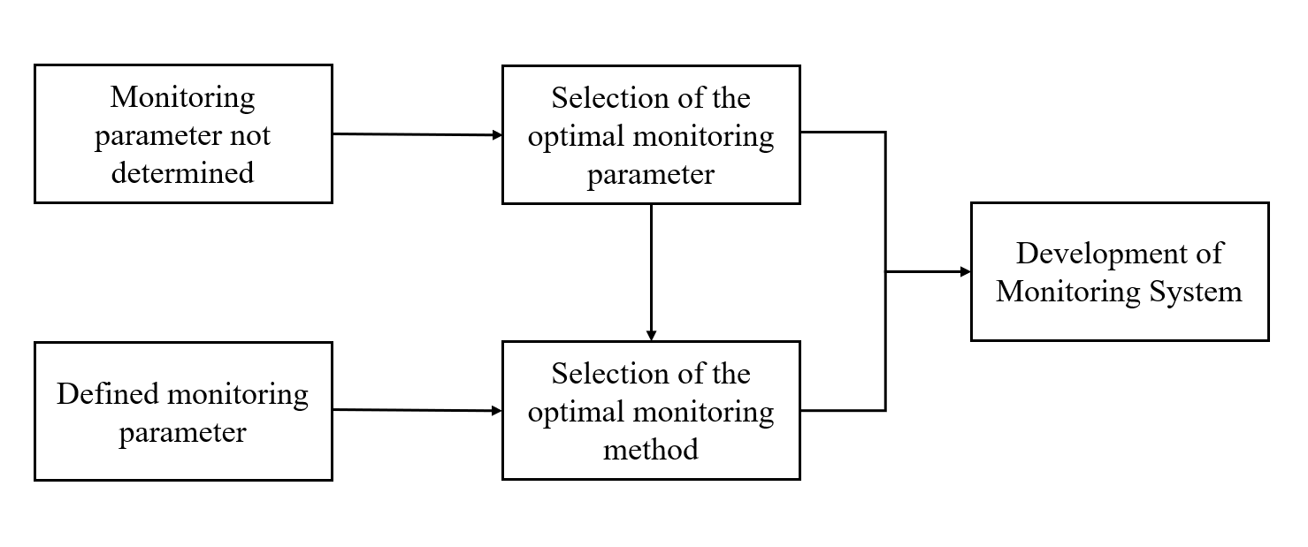
Methodology
Decision Support System
Advantage：
More comprehensive
Simplify the decision process
Reduced R&D costs
Decision Support System Framework
Development of a concept for data-based condition monitoring and structural health monitoring strategies for the use phase of hybrid components
04. August | Peiran Wang | Seit 12
Notes:
This is Decision Support System Framework
I designed the decision support system with two situations in mind (Consider two situations）
one is We have not yet determined the monitoring parameters, /pə'ræmɪtɚ/
We can use the first step to select the optimal monitoring parameters, and then get the best monitoring method by the second step.
Another situation is We have known monitoring parameter data.
We can directly use the second step of the decision system.
The advantage of this make the decision system more comprehensive and simplify the decision process.
Reason: There are many types of parameters to monitor and not all of them need to be analyzed.

Slide 17
Methodology
1. Selection of the optimal monitoring parameter
Analytic Hierarchy Process (AHP)
Analytic Hierarchy Process (AHP) is a decision method that divides a complex decision problem into several simple sub-problems.
A multi-layered analytical decision model is formed according to objective, criteria and alternative. Then each element weight is systematically evaluated by comparing each two at a time, and finally calculations and ranked to obtain the best solution.
Development of a concept for data-based condition monitoring and structural health monitoring strategies for the use phase of hybrid components
04. August | Peiran Wang | Seit 13
Notes:
The first step is the selection of the monitoring parameters,
I used the AHP method
Next I will explain the method in steps.
Analytic Hierarchy Process (AHP) is a decision making method that takes a complex decision problem and divided into several simple sub-problems to determine the weight of alternatives arrive at the best result.

Slide 18
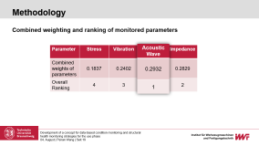
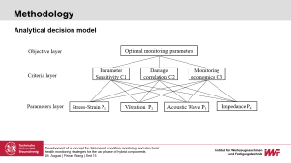
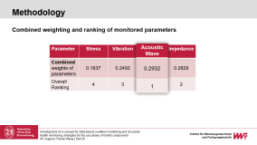
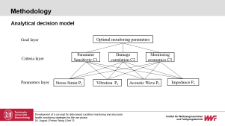
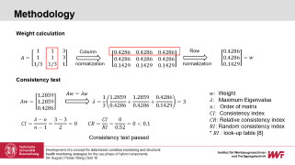
Methodology
Steps of AHP
Determine the decision model
End of Decision Analysis
Construct the judgment matrix
YES
Consistency testing
NO
Calculate the weight per layer
Consistency testing
NO
YES
Calculate the overall weight
Development of a concept for data-based condition monitoring and structural health monitoring strategies for the use phase of hybrid components
04. August | Peiran Wang | Seit 14
Notes:
Next I will explain the method in steps.
First I built the decision model by dividing the objective into three sub-objectives
Next is a compare between two elements of each layer for upper layer

Slide 19
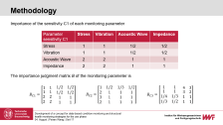
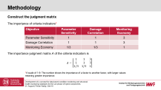
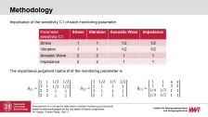
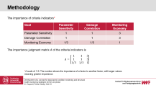
Methodology
Analytical decision model
Objective layer
Optimal monitoring parameters
Parameter Sensitivity C1
Damage correlation C2
Monitoring economics C3
Criteria layer
Parameters layer
Stress-Strain P₁
Vibration P₂
Acoustic Wave P₃
Impedance P₄
Development of a concept for data-based condition monitoring and structural health monitoring strategies for the use phase of hybrid components
04. August | Peiran Wang | Seit 15
Notes:
First I built the decision model by dividing the objective into three sub-objectives.
It is also 3 criterias of parameters.
Here are given 4 commonly used parameters.
The criteria weights for each parameter are different
Next is a compare between two elements of each layer for upper layer
First is the comparison between the criteria layer for the objective.
Then there is a comparison between the parameters for the criteria.

Slide 20
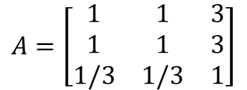
Methodology
Construct the judgment matrix
The importance of criteria indicators*
Objective | Parameter Sensitivity | Damage Correlation | Monitoring Economy
Parameter Sensitivity | 1 | 1 | 3
Damage Correlation | 1 | 1 | 3
Monitoring Economy | 1/3 | 1/3 | 1
The importance judgment matrix A of the criteria indicators is
$$A=\left[\begin{matrix}1 & 1 & 3 \\ 1 & 1 & 3 \\ 1/3 & 1/3 & 1\end{matrix}\right]$$
*A scale of 1-9: The number shows the importance of a factor to another factor, with larger values meaning greater importance.
Development of a concept for data-based condition monitoring and structural health monitoring strategies for the use phase of hybrid components
04. August | Peiran Wang | Seit 16
Notes:
First is the comparison between the criteria layer for the objective.
Here the importance is determined by the user According to the user's situation and wishes
the larger the number means the more important, and the judgment matrix is used to calculate the weight.
靠q late
美锤可死 /'kælkjulet/

Slide 21
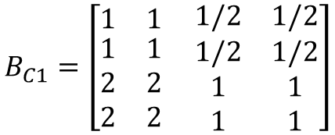
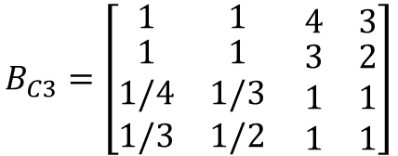
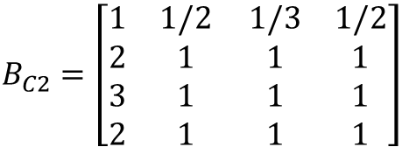
Methodology
Importance of the sensitivity C1 of each monitoring parameter
Parameter sensitivity C1 | Stress | Vibration | Acoustic Wave | Impedance
Stress | 1 | 1 | 1/2 | 1/2
Vibration | 1 | 1 | 1/2 | 1/2
Acoustic Wave | 2 | 2 | 1 | 1
Impedance | 2 | 2 | 1 | 1
The importance judgment matrix B of the monitoring parameter is
$$B_{C1}=\left[\begin{matrix}1 & 1 \\ \begin{aligned}1 \\ 2 \\ 2\end{aligned} & \begin{aligned}1 \\ 2 \\ 2\end{aligned}\end{matrix} \begin{matrix}1/2 & 1/2 \\ \begin{aligned}1/2 \\ 1 \\ 1\end{aligned} & \begin{aligned}1/2 \\ 1 \\ 1\end{aligned}\end{matrix}\right]$$
$$B_{C2}=\left[\begin{matrix}1 & 1/2 \\ \begin{aligned}2 \\ 3 \\ 2\end{aligned} & \begin{aligned}1 \\ 1 \\ 1\end{aligned}\end{matrix} \begin{matrix}1/3 & 1/2 \\ \begin{aligned}1 \\ 1 \\ 1\end{aligned} & \begin{aligned}1 \\ 1 \\ 1\end{aligned}\end{matrix}\right]$$
$$B_{C3}=\left[\begin{matrix}1 & 1 \\ \begin{aligned}1 \\ 1/4 \\ 1/3\end{aligned} & \begin{aligned}1 \\ 1/3 \\ 1/2\end{aligned}\end{matrix} \begin{matrix}4 & 3 \\ \begin{aligned}3 \\ 1 \\ 1\end{aligned} & \begin{aligned}2 \\ 1 \\ 1\end{aligned}\end{matrix}\right]$$
Development of a concept for data-based condition monitoring and structural health monitoring strategies for the use phase of hybrid components
04. August | Peiran Wang | Seit 17
Notes:
Then there is a comparison between the parameters for the criteria.
We can get 3 judgment matrix.
The importance number here is based on the literature or expert experience

Slide 22
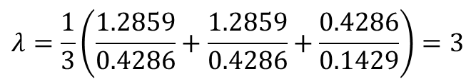
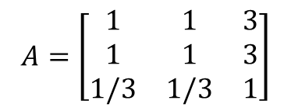

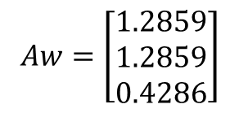
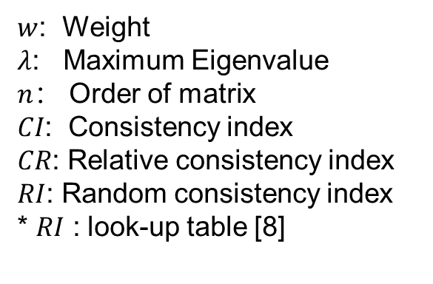
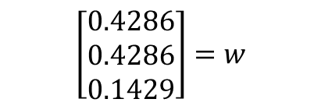
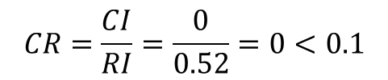
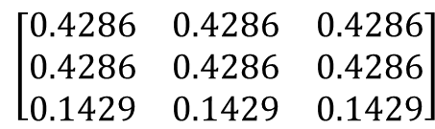

Methodology
Weight calculation
$$A=\left[\begin{matrix}1 & 1 & 3 \\ 1 & 1 & 3 \\ 1/3 & 1/3 & 1\end{matrix}\right]$$
Column
$$\left[\begin{matrix}0.4286 & 0.4286 & 0.4286 \\ 0.4286 & 0.4286 & 0.4286 \\ 0.1429 & 0.1429 & 0.1429\end{matrix}\right]$$
Row
$$\left[\begin{matrix}0.4286 \\ 0.4286 \\ 0.1429\end{matrix}\right]=w$$
normalization
normalization
Consistency test
$$Aw=\left[\begin{matrix}1.2859 \\ 1.2859 \\ 0.4286\end{matrix}\right]$$
$$Aw=λw$$
$w$: Weight
$λ$: Maximum Eigenvalue
$n$： Order of matrix
𝐶𝐼: Consistency index
$CR$: Relative consistency index
$RI$: Random consistency index
* $RI$ : look-up table [8]
$$λ=\frac{1}{3}\left(\frac{1.2859}{0.4286}+\frac{1.2859}{0.4286}+\frac{0.4286}{0.1429}\right)=3$$
$$CI=\frac{λ−n}{n−1}=\frac{3−3}{2}=0$$
$$CR=\frac{CI}{RI}=\frac{0}{0.52}=0<0.1$$
Consistency test passed
Development of a concept for data-based condition monitoring and structural health monitoring strategies for the use phase of hybrid components
04. August | Peiran Wang | Seit 18
Notes:
The third step is the weight calculation and consistency test,
the weight calculation is to make the data uniform and clearer,
and the consistency test is to ensure the logic of the data
* In the weight calculation, the judgment matrix is normalized and the maximum eigenvalue of the matrix is used to determine the consistency of the matrix.

Slide 23
Methodology
Weight calculation and consistency testing
Criteria layer
Criteria layer | Parameter Sensitivity C1 | Damage Correlation C2 | Monitoring Economy C3 | Maximum Eigenvalue | CR* | Consistency test
Weight | 0.4286 | 0.4286 | 0.1429 | 3.0000 | 0.000 | Pass
Parameter layer
*CR: Relative consistency index < 0.1
Parameter layer | Stress | Vibration | Acoustic Wave | Impedance | Maximum Eigenvalue | CR* | Consistency test
Parameter Sensitivity | 0.1667 | 0.1667 | 0.3333 | 0.3333 | 4.0000 | 0.000 | Pass
Damage Correlation | 0.1272 | 0.2804 | 0.3120 | 0.2804 | 4.0206 | 0.0061 | Pass
Monitoring Economy | 0.4039 | 0.3404 | 0.1166 | 0.1391 | 4.0310 | 0.0092 | Pass
Development of a concept for data-based condition monitoring and structural health monitoring strategies for the use phase of hybrid components
04. August | Peiran Wang | Seit 19
Notes:
By calculation we can get the weights and consistency test results for each layer

Slide 24
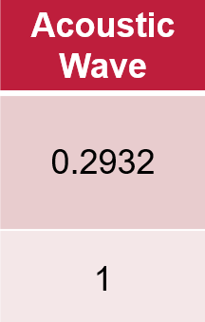
Methodology
Combined weighting and ranking of monitored parameters
Parameter | Stress | Vibration | Acoustic Wave | Impedance
Combined weights of parameters | 0.1837 | 0.2402 | 0.2932 | 0.2829
Overall Ranking | 4 | 3 | 1 | 2
Development of a concept for data-based condition monitoring and structural health monitoring strategies for the use phase of hybrid components
04. August | Peiran Wang | Seit 20
Notes:
Finally we got the combined weights of all parameters for the objective.
We can see that Acoustic Wave has the greatest weight
*Based on the user's choice, Acoustic Wave is the optimal monitoring parameter

Slide 25
Methodology
2. Selection of the optimal monitoring method
Rule-based reasoning (RBR)
Rule-based reasoning (RBR) is a logical reasoning method.
Firstly organizes a knowledge base (judgment matrix) based on various attribute labels of monitoring methods.
And then users select different sub-attributes based on actual information and wishes.
Finally reason through If-Then statement to arrive at the optimal monitoring method.
Development of a concept for data-based condition monitoring and structural health monitoring strategies for the use phase
04. August | Peiran Wang | Seit 21
Notes:
The second step of the decision system is the selection of the monitoring method.
I used Rule-based reasoning decision method.

Slide 26
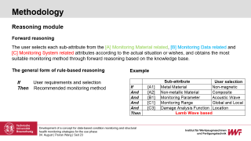
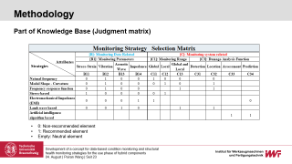
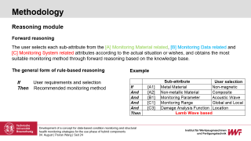
Methodology
Structure of rule-based reasoning decision system
Knowledge Base
Knowledge Acquisition
Literature/relevant experts
Reasoning Module
Reasoning guidance
Users
Development of a concept for data-based condition monitoring and structural health monitoring strategies for the use phase
04. August | Peiran Wang | Seit 22
Notes:
This is the structure of rule based reasoning decision system.
The most important modules are the knowledge base and the reasoning module

Slide 27
Methodology
Part of Knowledge Base (Judgment matrix)
0: Non-recommended element
1: Recommended element
Empty: Neutral element
Development of a concept for data-based condition monitoring and structural health monitoring strategies for the use phase of hybrid components
04. August | Peiran Wang | Seit 23
Notes:
Now showing the part of knowledge base.
it is built from the attributes of the monitoring methods.
Monitoring parameters, monitoring range, Damage analysis function.
The information of the knowledge base comes from the summary of literature cases.
0 means if the user chooses this attribute, the method for is not recommended /'rɛkə'mɛnd/
1 means recommended
The empty part means Neutral, can be used . /'nʊtrəl/ 牛丑儿

Slide 28
Methodology
Reasoning module
Forward reasoning
The user selects each sub-attribute from the [A] Monitoring Material related, [B] Monitoring Data related and [C] Monitoring System related attributes according to the actual situation or wishes, and obtains the most suitable monitoring method through forward reasoning based on the knowledge base.
The general form of rule-based reasoning
Example
If User requirements and selection
Then Recommended monitoring method
Development of a concept for data-based condition monitoring and structural health monitoring strategies for the use phase of hybrid components
04. August | Peiran Wang | Seit 24
Notes:
This is reasoning module
The reasoning module uses IF then statements,
user select each attribute according to their wishes and the actual situation
The recommended monitoring method is given through the reasoning module

Slide 29
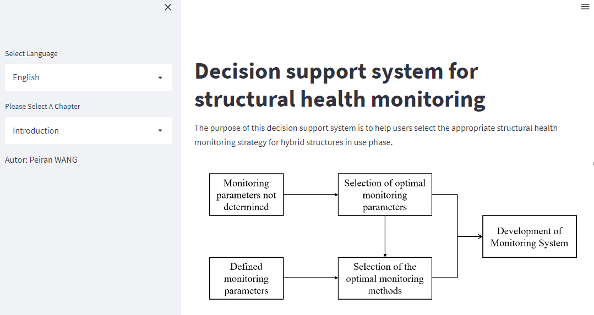
Methodology
3. Decision Support System Integration
Decision Support System by Streamlit [4]
Development of a concept for data-based condition monitoring and structural health monitoring strategies for the use phase of hybrid components
04. August | Peiran Wang | Seit 25
Notes:
In order to help users better understand and operate the whole decision support system,
I designed a web page using the streamlit platform.
Streamlit is a free framework to bulid web apps in Python.
-importance scores

Slide 30
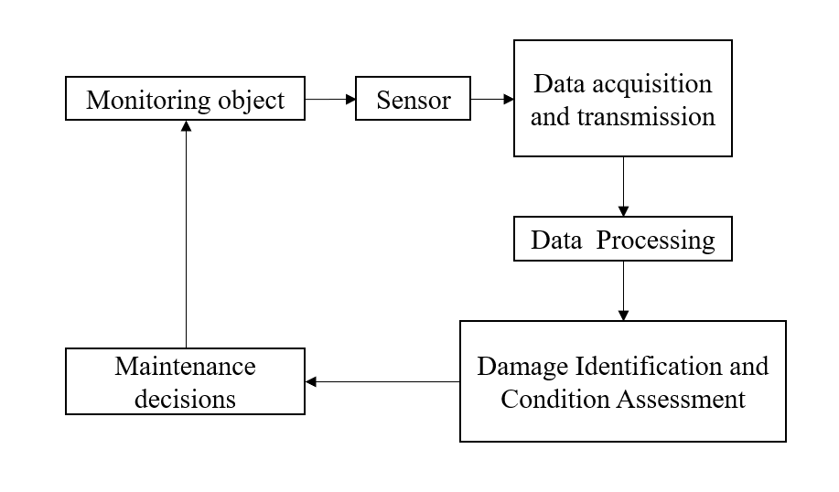
Methodology
4. Requirements for monitoring system
SHM system—Basic structure
Development of a concept for data-based condition monitoring and structural health monitoring strategies for the use phase of hybrid components
04. August | Peiran Wang | Seit 26
Notes:
In addition to decision system, I described about the monitoring system structure and requirements
This is SHM system Basic structure.
Based on this, monitoring systems can be designed

Slide 31
Methodology
System Functional Requirement
Data Quality and Transmission Requirement
Clear monitoring purpose
Clear system structure
Safety and reliability
Ensure the accuracy and completeness of data
Data stability, information security
Standardized data communication protocol
Perfect software and hardware equipment
Damage Identification Requirement
Installation & Maintenance Requirement
Sensitive damage characteristics
Stable sensor
Fast and efficient response capability
Easy to install and maintain
Universality: Reducing repetitive development costs
Development of a concept for data-based condition monitoring and structural health monitoring strategies for the use phase of hybrid components
04. August | Peiran Wang | Seit 27
Notes:
These are the design requirements for the monitoring system
For explem: Data Quality and Transmission Requirement
we should make sure Data stability, information security
And also need software and hardware. usb interface
More details are described in my thesis

Slide 32
Contents
Motivation and objective
State of the art
Methodology
Case Study
Summary and Critical appraisal
Outlook
Development of a concept for data-based condition monitoring and structural health monitoring strategies for the use phase of hybrid components
04. August | Peiran Wang | Seit 28
Notes:
Next part is the case study

Slide 33
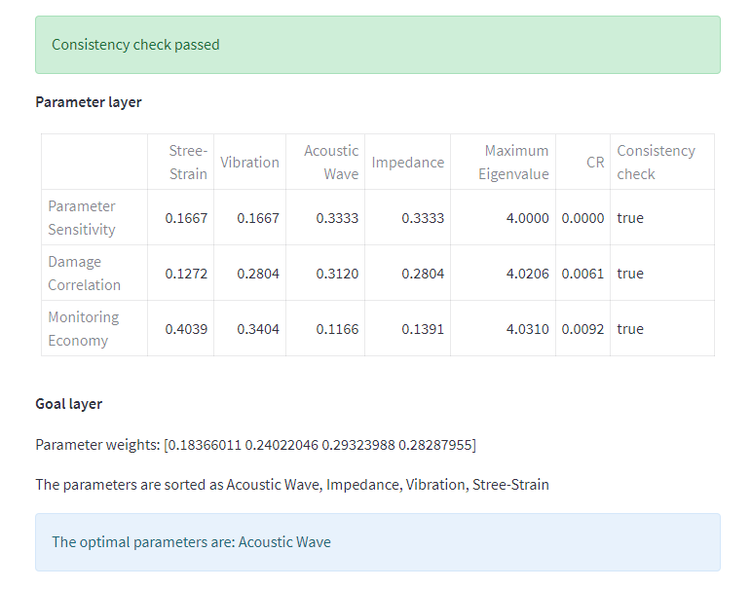
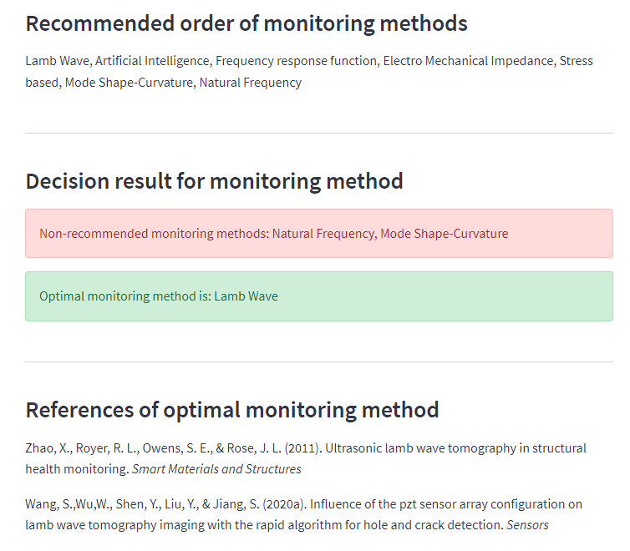
Case Study
Example: 400mm × 400mm Aluminum-Fiber composite laminate
Optimal monitoring parameter selection
Optimal monitoring parameter selection
Development of a concept for data-based condition monitoring and structural health monitoring strategies for the use phase of hybrid components
04. August | Peiran Wang | Seit 29
Notes:
I use a simple hybrid structural as example
4 hundred millimeter time 400 mm composite laminate
Through the decision support system I got the best monitoring parameters and monitoring method
Lamb wave based is the optimal Method.

Slide 34
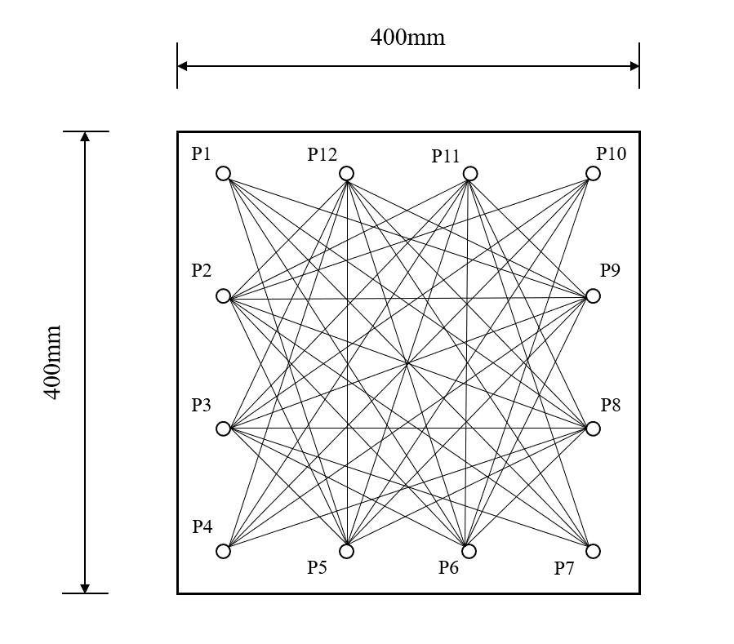
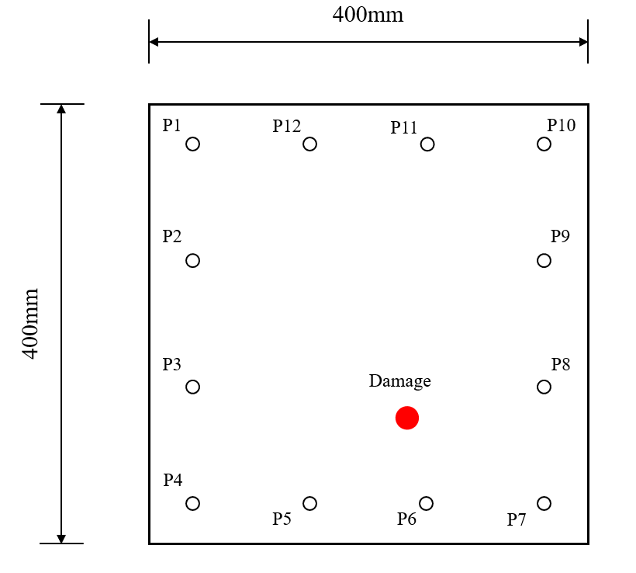
Case Study
Lamb wave-based SHM system development
Sensor Excitation - Sensing Networks
Damage model by ABAQUS
*PZT sensor: Piezoelectric sensor
Development of a concept for data-based condition monitoring and structural health monitoring strategies for the use phase of hybrid components
04. August | Peiran Wang | Seit 30
Notes:
I used finite element software, abaqus /'faɪnaɪt/ to simulation
Create Damage Model
Sensor Networks
*Sensors can both excite and receive signals

Slide 35
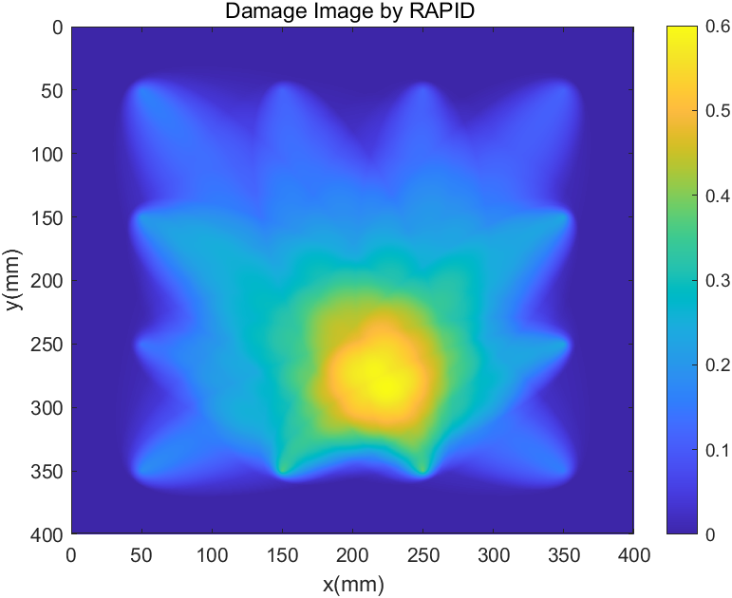
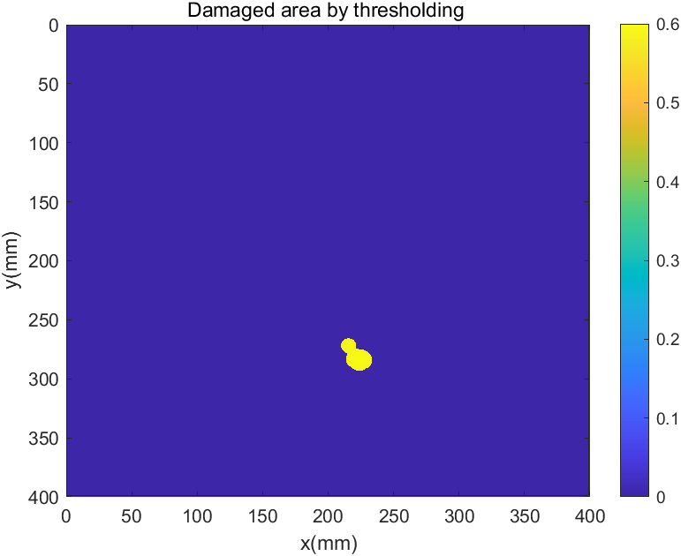
Case Study
Lamb wave-based SHM system - Damage Identification by MATLAb
Damage Image
Damaged area by thresholding
Development of a concept for data-based condition monitoring and structural health monitoring strategies for the use phase of hybrid components
04. August | Peiran Wang | Seit 31
Notes:
The damage factor is got by comparing the damaged and non-damaged signals
Finally, the location of the damage is calculated by Matlab
Analysed
Case study proves the feasibility of monitoring methods from designed decision support system.
非zer

Slide 36
Contents
Motivation and objective
State of the art
Methodology
Case Study
Summary and Critical appraisal
Outlook
Development of a concept for data-based condition monitoring and structural health monitoring strategies for the use phase of hybrid components
04. August | Peiran Wang | Seit 32

Slide 37
Summary and Critical appraisal
Summary
A decision support system was developed to help the user select the suitable monitoring strategy for the hybrid structure in use phase. The optimal monitoring parameter and monitoring method are determined. The requirements of each structure of the monitoring system are also summarized to help the user can design a complete monitoring system.
Critical appraisal
The decision support system uses two decision methods, which makes the development more difficult and should increase the relevance of both.
Lack of relevant work experience and possibly incomplete knowledge of the influencing factors of the monitoring environment.
The study case is a simple structure and should be further tested with a more complex hybrid structure.
Development of a concept for data-based condition monitoring and structural health monitoring strategies for the use phase of hybrid components
04. August | Peiran Wang | Seit 33
Notes:
Of course, the designed decision support system has some shortcomings.
I used two decision methods, which made the study more difficult
Because I lack relevant work experience, may not have been complete/comprehensive consideration
Case studies need to test more complex structures

Slide 38
Contents
Motivation and objective
State of the art
Methodology
Case Study
Summary and Critical appraisal
Outlook
Development of a concept for data-based condition monitoring and structural health monitoring strategies for the use phase of hybrid components
04. August | Peiran Wang | Seit 34

Slide 39
Outlook
Future research directions for decision systems
More examples of advanced monitoring methods
Expending the functional range of the decision support system, e.g:
Selection of sensors
Data transmission methods
Damage identification details
More consideration of the economics of monitoring strategies
Development of a concept for data-based condition monitoring and structural health monitoring strategies for the use phase of hybrid components
04. August | Peiran Wang | Seit 35
Notes:
Finally I give some future research directions
Expand the functional range of the decision support system.
It may be possible to achieve more decision function such as sensor selection, selection of data transmission methods, etc
The economy of monitoring strategies can be considered more in the future
* Because this thesis mainly considers the feasibility of monitoring methods,
Not enough consideration for economy , so in the future more consideration about economy of monitoring strategies should be given

Slide 40
References
[1] Dr. Friedbert W. (2015). DAS GUT GEHÜTETE GEHEIMNIS: DER NEUE BMW 7ER – HIGH TECH VOM FEINSTEN. https://der-autotester.de/bmw-7er-2015/
[2] Pudenz, K. (2015). Der neue bmw 7er mit carbon core: 130 kg leichter. https://www.springerprofessional.de/automobil---motoren/werkstoffe/der-neue-bmw-7er-mit-carbon-core-130-kg-leichter/6585360
[3] Grace N. (2021). Manna Laminates FEATURE organosheet laminate targets EMS applications. https://www.compositesworld.com/products/manna-laminates-feature-organosheet-laminate-targets-ems-applications
[4] Rucker, W., Hille, F., & Rohrmann, R. (2006). Guideline for structural health monitoring. Report “F08b”. German Federal Institute of Materials Research and Testing (BAM), Berlin, Germany
[5] Daum, W. (2013). Guidelines for structural health monitoring. Handbook of technical diagnostics (pp. 539–541). Springer
[6] Cappello, C. (2017). Theory of decision based on structural health monitoring (Doc-toral dissertation). University of Trento
[7] Anderlik, S., Stumptner, R., Freudenthaler, B., & Fritz, M. (2010). A proposal forontology-based integration of heterogeneous decision support systems for structural health monitoring. Proceedings of the 12th International Conference on Information Integration and Web-based Applications & Services, 168–175
[8] Wind, Y., & Saaty, T. L. (1980). Marketing applications of the analytic hierarchy process. Management science, 26(7), 641–658
[9] Wang, P. (2022). Decision support system for structural health monitoring. https://peiran-wang-masterarbeit-shm-dss-ymotte.streamlitapp.com
Development of a concept for data-based condition monitoring and structural health monitoring strategies for the use phase of hybrid components
04. August | Peiran Wang | Seit 36

Slide 41
Vielen Dank für Ihre Aufmerksamkeit
Development of a concept for data-based condition monitoring and structural health monitoring strategies for the use phase of hybrid components
04. August | Peiran Wang | Seit 37
Notes:
That concludes my presentation.
Thank you so much for your interest and attention.
Vielen Dank für Ihre Aufmerksamkeit

